Slide 1

Early prediction of Diabetes Mellitus using intensive care data
to improve clinical decisions
Date: 13 May 2021
Thumuluri Sai Sarika - 17WH1A0519
CH Aparna - 18WH5A0503
Y Kavya - 18WH5A0505
Internal Guide: Ms.Shanti Gunna
Designation: Assistant Professor
Department of Computer Science & Engineering
BVRIT HYDERABAD College of Engineering for Women

Slide 2

BACKGROUND
Getting a rapid understanding of the context of a patient’s overall health has been particularly important during the COVID-19 pandemic as healthcare workers around the world struggle with hospitals overloaded by patients in critical condition.
Intensive Care Units (ICUs) often lack verified medical histories for incoming patients. A patient in distress or a patient who is brought in confused or unresponsive may not be able to provide information about chronic conditions such as heart disease, injuries, or diabetes. Medical records may take days to transfer, especially for a patient from another medical provider or system.
Knowledge about chronic conditions such as diabetes can inform clinical decisions about patient care and ultimately improve patient outcomes.
BVRIT HYDERABAD College of Engineering for Women

Slide 3

Why Should I Study this course?
ABSTRACT
Diabetes Mellitus (DM) is a condition induced by unregulated diabetes that may lead to multi-organ failure in patients. Thanks to advances in machine learning and artificial intelligence, which enables the early detection and diagnosis of DM through an automated process which is more advantageous than a manual diagnosis.
The objective is to build the model which determines whether a patient admitted to an ICU has been diagnosed with a particular type of diabetes, Diabetes Mellitus using data from the first 24 hours of intensive care and find the optimal classifier to give the closest result comparing to clinical outcomes. The aim is to focus on selecting the attributes that ail in early detection of Diabetes Mellitus using Predictive analysis with Logistic Regression and Light Gradient Boosting Machine techniques.
Examples
BVRIT HYDERABAD College of Engineering for Women

Slide 4
DATASET
Dataset Description:
The data is from MIT’s GOSSIS (Global Open Source Severity of Illness Score) initiative. The datasets consist of patient’s data from the first 24 hours of intensive care.
Training dataset - 130157 rows, 181 columns
Testing dataset - 10324 rows, 180 columns
Attribute | Description
encounter_id | Unique identifier associated with a patient unit stay
hospital_id | Unique identifier associated with a hospital
age | The age of the patient on unit admission

Slide 5
bmi | The body mass index of the person on unit admission
elective_surgery | Whether the patient was admitted to the hospital for an elective surgical operation
ethnicity | The common national or cultural tradition which the person belongs to
gender | The genotypical sex of the patient
height | The height of the person on unit admission
hospital_admit_source | The location of the patient prior to being admitted to the hospital
icu_admit_source | The location of the patient prior to being admitted to the unit
icu_admit_type | The type of unit admission for the patient
icu_id | A unique identifier for the unit to which the patient was admitted

Slide 6
icu_type | A classification which indicates the type of care the unit is capable of providing
pre_icu_los_days | The length of stay of the patient between hospital admission and unit admission
readmission_status | Whether the current unit stay is the second (or greater) stay at an ICU within the same hospitalization
weight | The weight (body mass) of the person on unit admission
albumin_apache | The albumin concentration measured during the first 24 hours which results in the highest APACHE III score
apache_2_diagnosis | The APACHE II diagnosis for the ICU admission
apache_3j_diagnosis | The APACHE III-J sub-diagnosis code which best describes the reason for the ICU admission

Slide 7
ARCHITECTURE
Intensive care patient dataset
Data Cleaning and Wrangling
Applying Classification
Algorithms
EDA
Performance Evaluation
Results
Data Visualization
BVRIT HYDERABAD College of Engineering for Women

Slide 8
TECHNOLOGY STACK
Supervised Machine Learning
Python Language
Required Packages:
Numpy
Pandas
Os
Klib
Warnings
Matplotlib
Seaborn
lightgbm
sklearn
sklearn.linear_model.LogisticRegression
sklearn.ensemble.RandomForestClassifier
sklearn.model_selection

Slide 9
Hardware:
Processor - Intel Core i5
Memory(RAM) - 8 GB
Storage – I TB
Software:
Python3
Google Colab/Jupyter Notebook
SYSTEM SPECIFICATIONS

Slide 10
TIMELINE
Review 0 | Abstract Requirements and Specifications
Review 1 | Dataset collection Exploratory Data Analysis Data Cleaning and Wrangling
Review 2 | Applying Classification Algorithms
Review 3 | Interpretation of Results

Slide 11
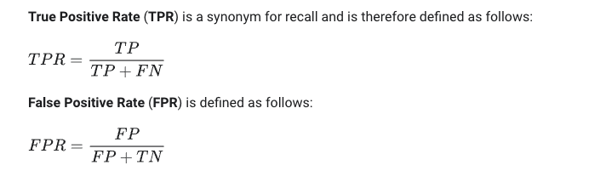
Evaluation Metric
Area under the Receiver Operating Characteristic (ROC) curve between the predicted and the observed target (diabetes mellitus)
An ROC curve (receiver operating characteristic curve) is a graph showing the performance of a classification model at all classification thresholds. This curve plots two parameters:

Slide 12
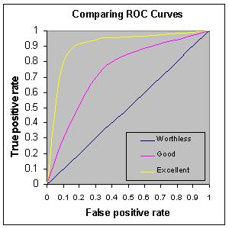
An ROC curve plots TPR vs. FPR at different classification thresholds. Lowering the classification threshold classifies more items as positive, thus increasing both False Positives and True Positives.
AUC ranges in value from 0 to 1.

Slide 13
Logistic Regression
Logistic Regression is the famous Machine Learning Algorithms which come under supervised learning technique.
These algorithm is of supervised in nature hence these algorithms use labeled dataset to make the predictions.
Logistic regression is used to predict the categorical dependent variable with the help of independent variables.
The output of Logistic Regression problem can be only between the 0 and 1.

Slide 14
Random Forest
Random Forest is a popular machine learning algorithm that belongs to the supervised learning technique.
Random Forest is a classifier that contains a number of decision trees on various subsets of the given dataset and takes the average to improve the predictive accuracy of that dataset.
The greater number of trees in the forest leads to higher accuracy and prevents the problem of overfitting.

Slide 15
LGBM - Light Gradient Boosting Machine
Light GBM is a fast, distributed, high-performance gradient boosting framework based on decision tree algorithm, used for ranking, classification and many other machine learning tasks.
It splits the tree leaf wise.
This can lead to overfitting which can be minimised by defining the depth for splitting.
Hyper-parameters can be optimised to increase performance.

Slide 16
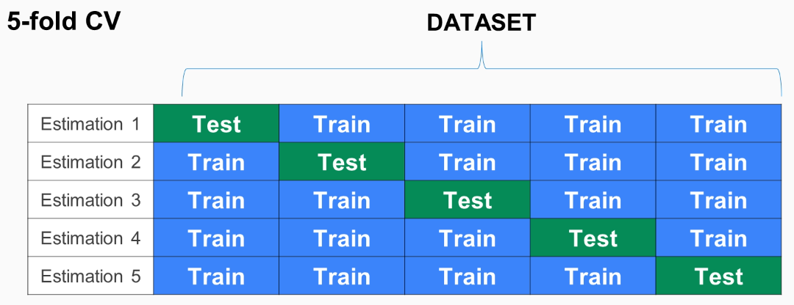
Cross Validation
K-Fold Cross Validation: Fold’ refers to each different iteration that the model will be trained on, and ‘k’ refers to the number of folds.
Stratified K-fold: Data would be split in such a way that same class distribution is maintained in each subset.

Slide 17
Comparative Study
Classifiers | roc_auc_score
Logistic Regression | 0.638
Random Forest | 0.824
LGBM | 0.845

Slide 18
Base paper
Journal of King Saud University Computer and Information Sciences- Machine learning and artificial intelligence based Diabetes Mellitus detection and self-management:JyotismitaChakiaS.Thillai GaneshbS.KCidhambS.Ananda Theertan - https://www.sciencedirect.com/science/article/pii/S1319157820304134

Slide 19
References
Analysis of diabetes mellitus for early prediction using optimal features selection - https://journalofbigdata.springeropen.com/articles/10.1186/s40537-019-0175-6
Prediction of Diabetes Using Machine Learning Algorithms in Healthcare- https://ieeexplore.ieee.org/document/8748992
Predictive models for diabetes mellitus using machine learning techniques - https://bmcendocrdisord.biomedcentral.com/articles/10.1186/s12902-019-0436-6

Slide 20
Thankyou
BVRIT HYDERABAD College of Engineering for Women

